Slide 1
STUDY OF NETWORK DEVICES
-SNAPDRAGON

Slide 2
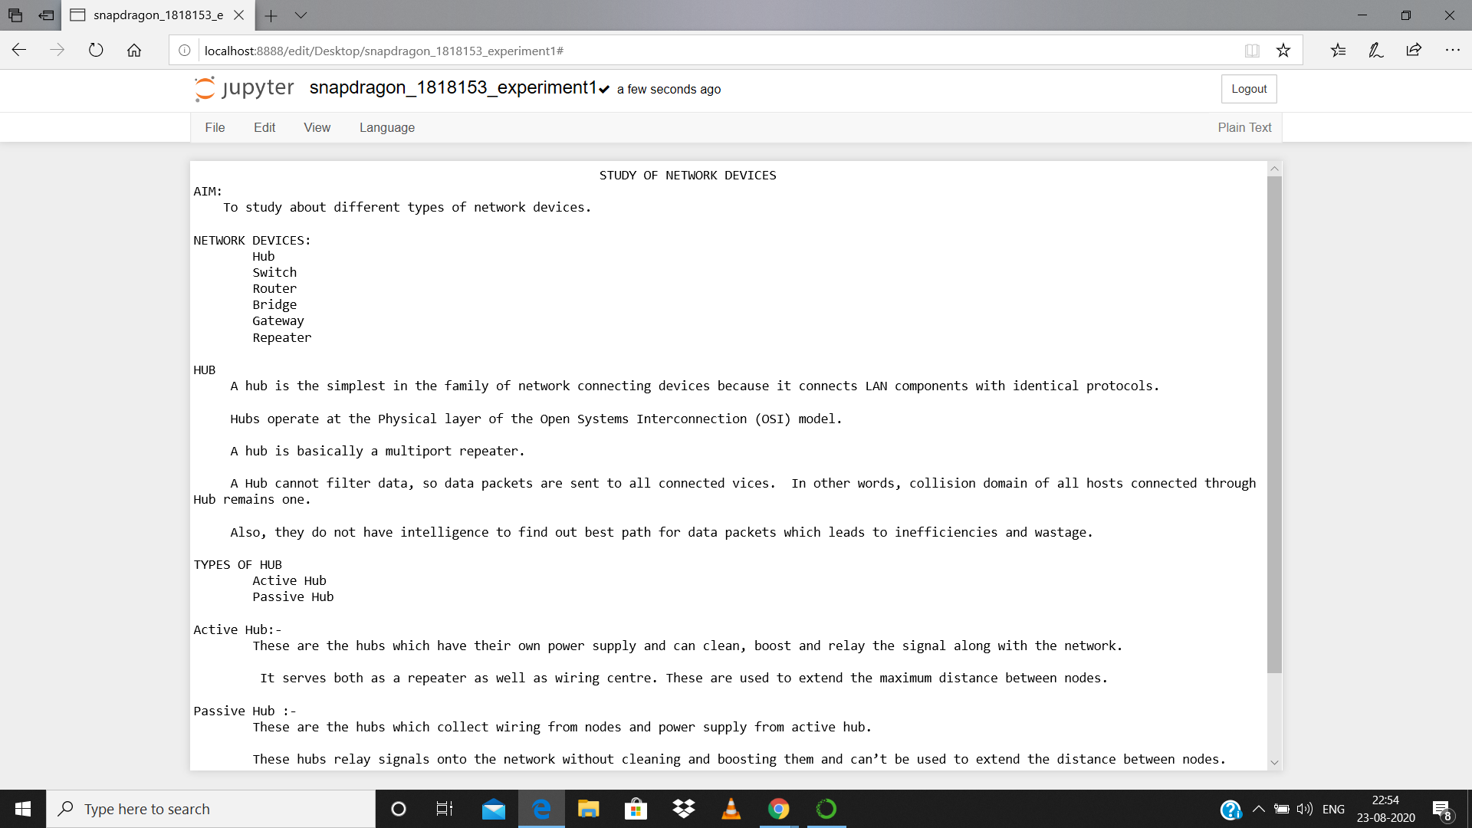

Slide 3
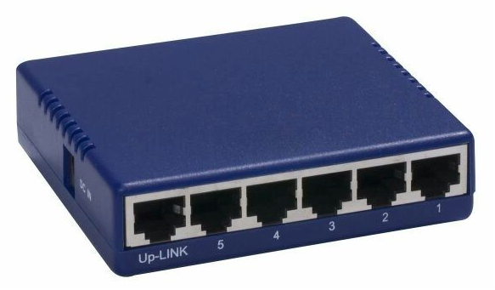
HUB

Slide 4
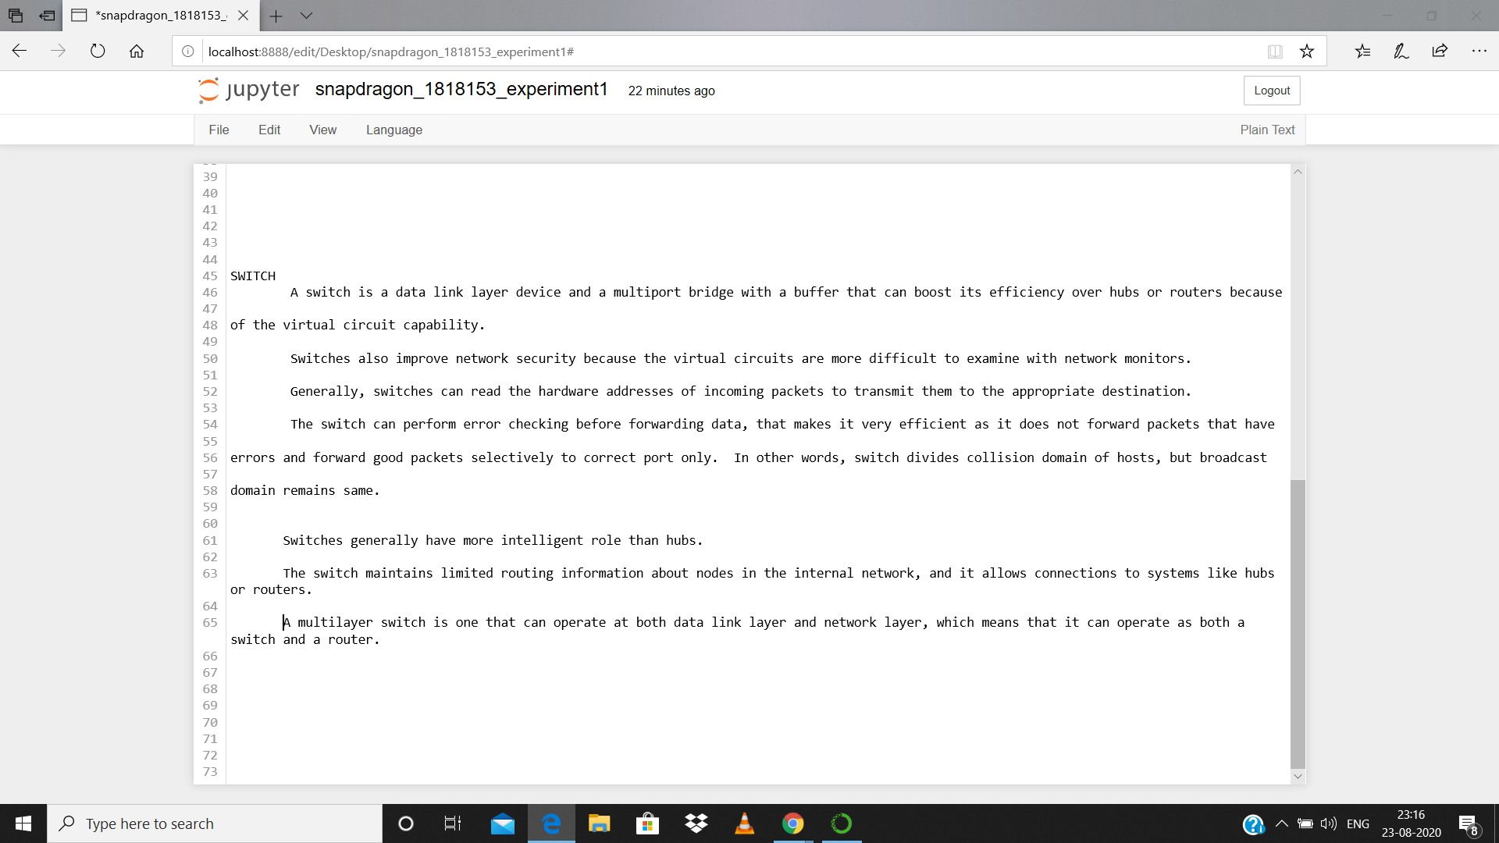

Slide 5

SWITCH

Slide 6
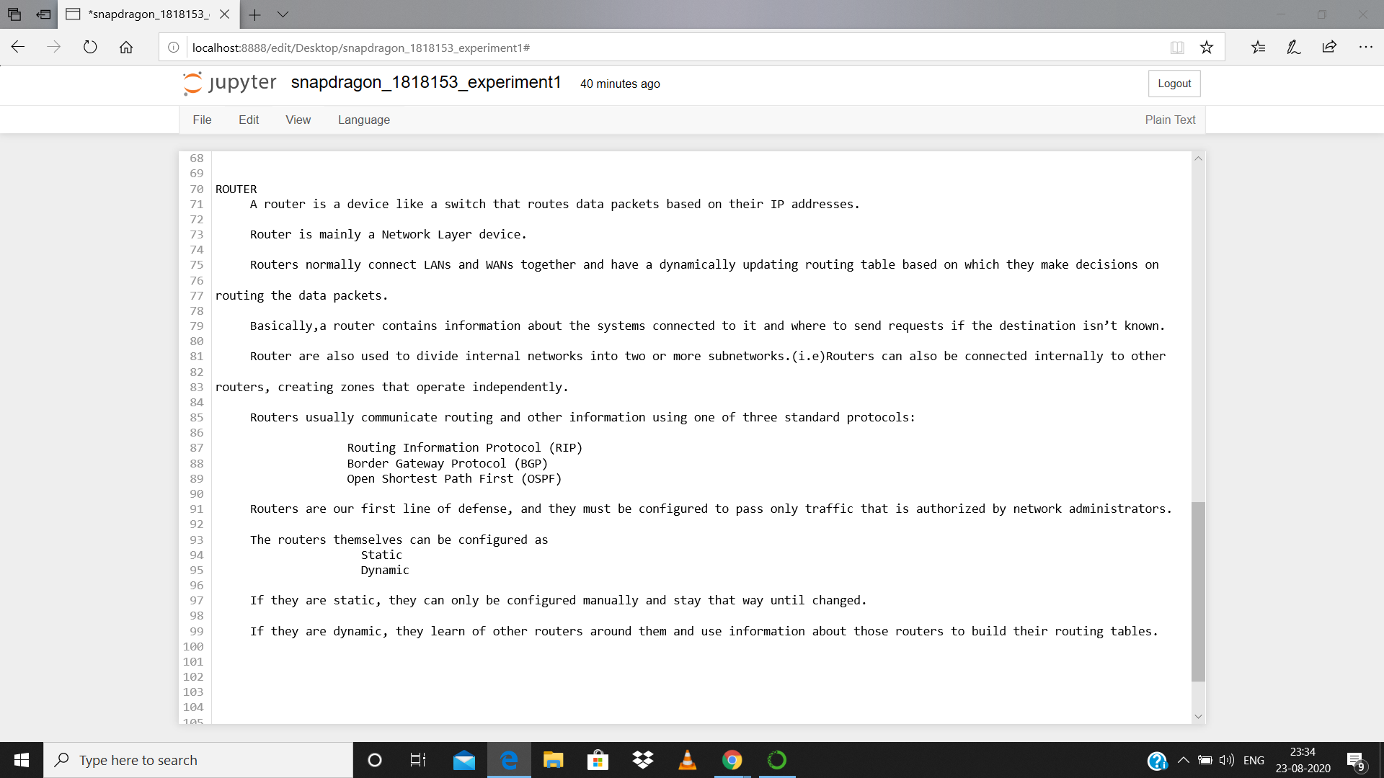

Slide 7
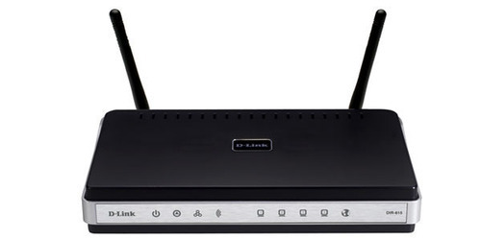
ROUTER

Slide 8
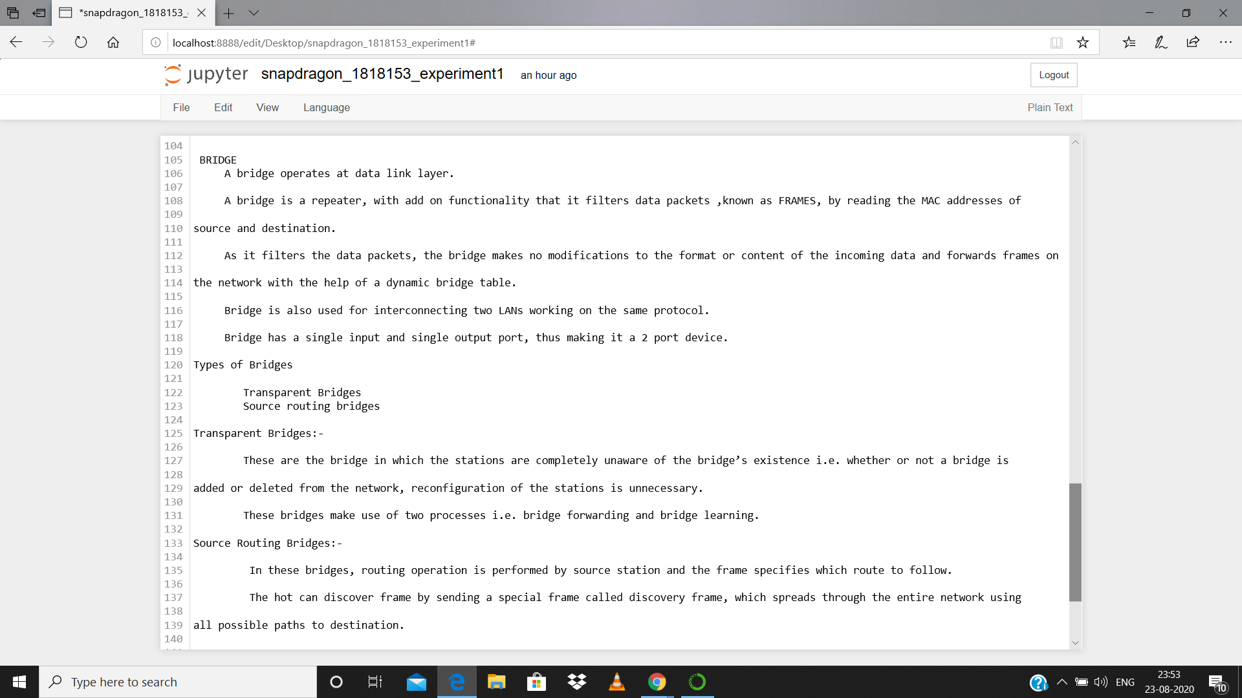

Slide 9
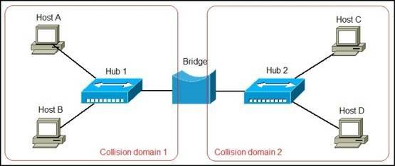
BRIDGE

Slide 10


Slide 11
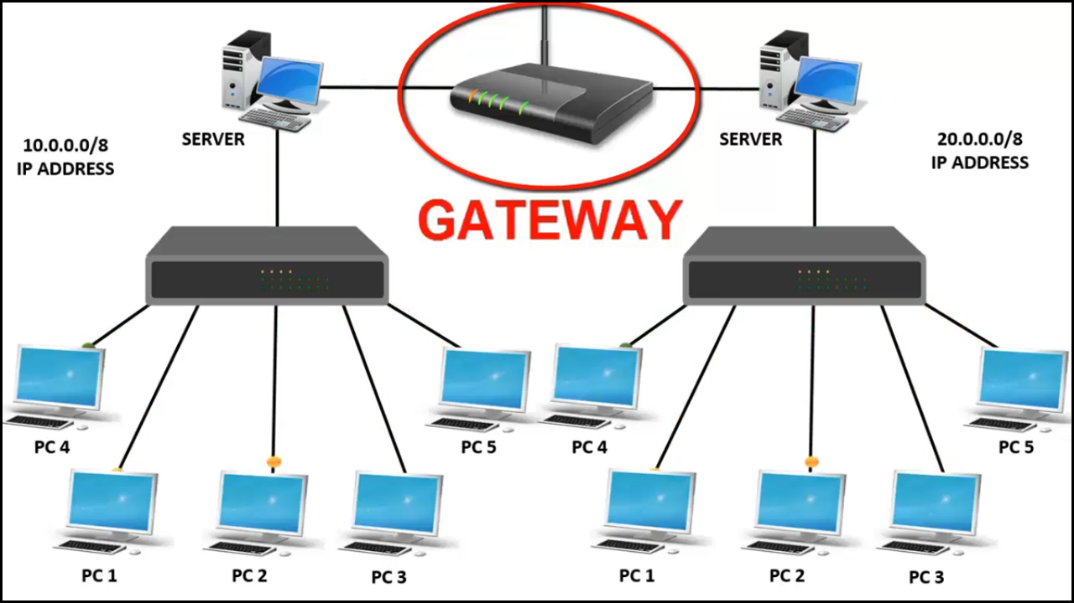
GATEWAY

Slide 12


Slide 13
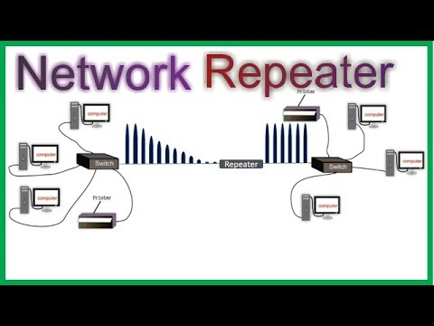
REPEATERS

Slide 14
RESULT
Thus the study of network devices were completed successfully.

